Slide 1


Image Processing with Hadoop Framework
Presentation by
Priya Patel 225589 priyapatel.3m@gmail.com

Slide 2
Agenda of Presentation
What is Image Processing?
Why we need to delete duplicate images?
What is big data?
What is Motivation behind?
What are current issues?
Examples of related Technical Papers
How we approach?
How it works?
Results should be like?

Slide 3
What is Image Processing?
In imaging science, image processing is any form of signal processing for which the input is an image, such as a photograph or video frame; the output of image processing may be either an image or a set of characteristics or parameters related to the image.[1]

Slide 4
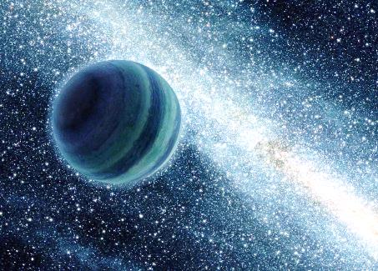
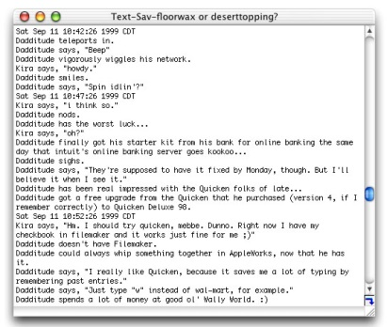

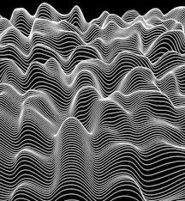

Image Processing

Slide 5
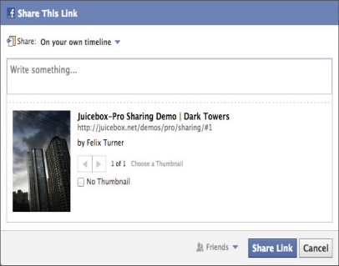



Why we need to delete duplication?

Slide 6

Big Data
Big data is an all-encompassing term for any collection of data sets so large and complex that it becomes difficult to process them using traditional data processing applications.[2]
Examples of Big Data:
CCTV Footages
Social Media Files
Gmail Logs
Medical Data
Online Shopping Data
Airline Details
During 1990 – 64mb to 128 mb RAM size &
Data Storage 1 GB to 20 GB
2014 – 4 GB to 16 GB & Data Storage 1 TB
90 % Data come within last 2 year.

Slide 7
Motivation
Social Media Usage and Big Data Issue
Facebook image sharing, YouTube video buffer
Data storage and retrieval Issue
Hadoop over RDMS

Slide 8
RDMS VS Hadoop
RDBMS: Data are being brought from a data store into the analytics layer to perform analysis.
Issues related to RDMS:
But as the data size grew it became more difficult to bring data from the data layer into the analytics layer to perform computations.
Count Distinct Queries: Sorting & Counting
Cursors: Row by Row stepping
Alter Table : adding column / changing Data type
Data Merge and Mash up

Slide 9
RDBMS vs Hadoop
Hadoop is basically a distributed file system (HDFS) which handles data redundancy using MapReduce.[4]
Hadoop offers massive scale in processing power and storage at a very low comparable cost to an RDBMS.
Parallel Processing, adding n number of nodes in cluster.
Hadoop works well with structured as well as unstructured data.
Drives up network costs and drives down throughput

Slide 10
Technical Papers
Hadoop Optimization for Massive Image Processing: Case Study Face Detection
By İ. Demir, A. Sayar[5]
Recognization of Satellite Images of Large Scale Data Based On Map-
Reduce Framework By Vidya Dhondiba Jadhav, Harshada Jayant Nazirkar, Sneha Manik Idekar[6]
Astronomy in the Cloud: Using MapReduce for Image Coaddition By K. Wiley, A. Connolly, J. Gardner and S. Krughoff [7]

Slide 11
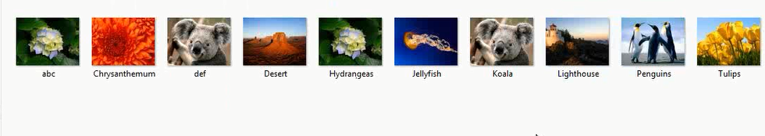
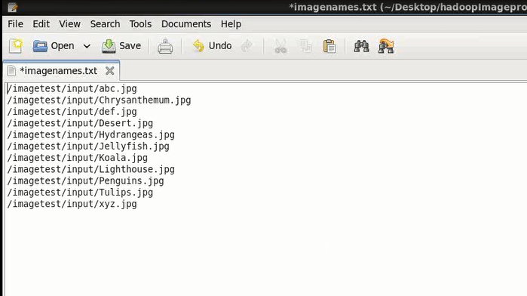
How we approach ?
Image file as a Input (Store in local System).

Slide 12
All image files are available in Hadoop File System and ready to Process. Step 1: we took a certain number of Input Images and stored it into Hadoop File System. Here we used Java Map reduce code. Step 2: All the Image which we took, we converted those in sequence file. Step 3: Comparison of sequence file with one another. Step 4: Identified the duplicate Images. Step 5: Removed the duplicate images from Hadoop File System.

Slide 13
How it works?
1) Configure a Hadoop Cluster
2) Build a Map Reduce algorithm which is going to convert image Files in to Sequence File Format.
3) Build a Map Reduce algorithm which is going to identify duplicate files and remove them from your File System.
What we are going to do is build an algorithm which is going delete all these duplicate files from Hadoop File System (HDFS).

Slide 14
Result should be like:
It will remove the marked images and result into less memory space occupied in system.
Remove them effectively and carefully can give us huge vacant space and speed in surfing.

Slide 15
conclusion
Social Media web Sites like Facebook, Twitter etc. have a number of users who share and upload pictures and videos.
Sometime Image file with same name, same format, same resolution and same size is shared by multiple users all these Images are stored in the Data Base even though it carries a same properties.
This doesn’t look good as duplicate files occupied needless space in File System.
Overcome this issue this is the best technologies to the computer world. i.e Image Processing.

Slide 16
References
http://www.disi.unige.it/person/RovettaS/rad/image-processing-wikipedia-book.pdf
Data, data everywhere". The Economist. 25 February 2010. Retrieved9 December 2012.
https://hadoop.apache.org/
"Hadoop Releases". apache.org. Apache Software Foundation. Retrieved 2014-12-06.
https://www.google.com/url?sa=t&rct=j&q=&esrc=s&source=web&cd=1&ved=0CB8QFjAA&url=http%3A%2F%2Funivagora.ro%2Fjour%2Findex.php%2Fijccc%2Farticle%2Fdownload%2F285%2Fpdf_142&ei=dRFJVdXJCs2eyATUs4HYBg&usg=AFQjCNHjQs0b8e6p9qa6eqXHXOTBovcnRA
http://ijaeit.com/Paper-Pdf/Paper%208.pdf
http://ssg.astro.washington.edu/downloadable/PASP2011_AstronomyInTheCloud.pdf

Slide 17
Thank You

